Slide 1

What is Learning ?
Madan Mohan Malaviya Univ. of Technology, Gorakhpur
“Learning denotes changes in a system that enable a system to do the
same task more efficiently the next time.” - Herbert Simon
“Learning is constructing or modifying representations of what is being experienced.” - Ryszard Michalski
“Learning is making useful changes in our minds.”
- Marvin Minsky

Slide 2
Why Learning ?
Madan Mohan Malaviya Univ. of Technology, Gorakhpur
Learning is used when:
Human expertise does not exist (Ex. navigating on Mars)
Humans are unable to explain their expertise (Ex. speech recognition)
Solution changes in time (Ex. routing on a computer network)
Solution needs to be adapted to particular cases ( Ex. user biometrics )

Slide 3
What is Machine Learning ?
Madan Mohan Malaviya Univ. of Technology, Gorakhpur
Machine learning (ML) is a type of artificial intelligence (AI) that allows software applications to become more accurate at predicting outcomes without being explicitly programmed to do so. Machine learning algorithms use historical data as input to predict new output values
Machine learning is the study of computer algorithms that improve automatically through experience
Machine learning algorithms build a mathematical model based on sample data, known as "training data", in order to make predictions or decisions without being explicitly programmed to do so
Machine learning algorithms are used in a wide variety of applications, such as email filtering and computer vision, where it is difficult or infeasible to develop conventional algorithms to perform the needed tasks

Slide 4
What is Machine Learning ?
Madan Mohan Malaviya Univ. of Technology, Gorakhpur
Machine learning employs various approaches to teach computers to accomplish tasks where no fully satisfactory algorithm is available
For simple tasks assigned to computers, it is possible to program algorithms telling the machine how to execute all steps required to solve the problem at hand; on the computer's part, no learning is needed
For more advanced tasks, it can be challenging for a human to manually create the needed algorithms
In practice, it can turn out to be more effective to help the machine develop its own algorithm, rather than having human programmers specify every needed step

Slide 5
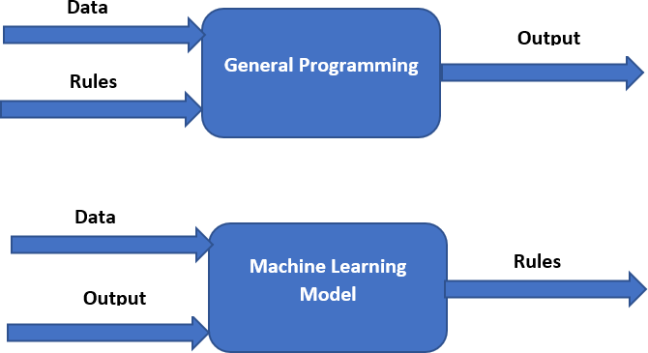
What is Machine Learning ?
Madan Mohan Malaviya Univ. of Technology, Gorakhpur

Slide 6
What is Machine Learning ?
Madan Mohan Malaviya Univ. of Technology, Gorakhpur
Machine Learning vs Data Mining
Machine learning and data mining often employ the same methods and overlap significantly
but while machine learning focuses on prediction, based on known properties learned from the training data
Where as data mining focuses on the discovery of (previously) unknown properties in the data (this is the analysis step of knowledge discovery in databases)
Data mining uses many machine learning methods, but with different goals

Slide 7
What is Machine Learning ?
Madan Mohan Malaviya Univ. of Technology, Gorakhpur
Machine Learning vs Data Mining
On the other hand, machine learning also employs data mining methods as "unsupervised learning" or as a preprocessing step to improve learner accuracy
Data mining is a related field of study, focusing on exploratory data analysis through unsupervised learning
In its application across business problems, machine learning is also referred to as predictive analytics

Slide 8
What is Machine Learning ?
Madan Mohan Malaviya Univ. of Technology, Gorakhpur
Machine Learning vs Optimization
Machine learning also has intimate ties to optimization: many learning problems are formulated as minimization of some loss function on a training set of examples.
Loss functions express the discrepancy between the predictions of the model being trained and the actual problem instances.
The difference between the two fields arises from the goal of generalization:

Slide 9
What is Machine Learning ?
Madan Mohan Malaviya Univ. of Technology, Gorakhpur
Machine Learning vs Optimization
Optimization algorithms can minimize the loss on a training set while machine learning is concerned with minimizing the loss on unseen samples
The study of optimization delivers methods, theory and application domains to the field of machine learning

Slide 10
What is Machine Learning ?
Madan Mohan Malaviya Univ. of Technology, Gorakhpur
Machine Learning vs Statistics
Machine learning is closely related to computational statistics, which focuses on making predictions using computers
Machine learning and statistics are closely related fields in terms of methods, but distinct in their principal goal: statistics draws population inferences from a sample, while machine learning finds generalizable predictive patterns
Leo Breiman distinguished two statistical modeling paradigms: data model and algorithmic model wherein "algorithmic model" means more or less the machine learning algorithms

Slide 11
What is Machine Learning ?
Madan Mohan Malaviya Univ. of Technology, Gorakhpur
Machine Learning vs Data Science
Data science as a broader term not only focuses on algorithms and statistics but also takes care of the entire data processing methodology
Data science is an inter-disciplinary field that uses scientific methods, processes, algorithms and systems to extract knowledge and insights from many structural and unstructured data
Data science is related to data mining, machine learning and big data
Data science is a "concept to unify statistics, data analysis and their related methods" in order to understand and analyze actual phenomena with data

Slide 12
What is Machine Learning ?
Madan Mohan Malaviya Univ. of Technology, Gorakhpur
Machine Learning vs Deep Learning
Machine learning uses algorithms to parse data, learn from that data, and make informed decisions based on what it has learned
Deep learning algorithms in layers to create an "artificial neural network” that can learn and make intelligent decisions on its own
Deep learning is what powers the most human-like artificial intelligence
Deep learning is a subfield of machine learning. While Machine Learning is subfield of artificial intelligence
As of 2020, deep learning has become the dominant approach for much ongoing work in the field of machine learning

Slide 13
What is Machine Learning ?
Madan Mohan Malaviya Univ. of Technology, Gorakhpur
Machine Learning vs Artificial Intelligence
Artificial intelligence (AI) brings with it a promise of genuine human-to- machine interaction. When machines become intelligent, they can understand requests, connect data points and draw conclusions. They can reason, observe and plan
AI contains many subfields, including:
Machine learning automates analytical model building. While machine learning is based on the idea that machines should be able to learn and adapt through experience, AI refers to a broader idea where machines can execute tasks smartly
Neural network is a kind of machine learning inspired by the workings of the human brain

Slide 14
What is Machine Learning ?
Madan Mohan Malaviya Univ. of Technology, Gorakhpur
Machine Learning vs AI
Deep learning uses huge neural networks with many layers of processing units, taking advantage of advances in computing power and improved training techniques to learn complex patterns in large amounts of data. Common applications include image and speech recognition
Computer vision relies on pattern recognition and deep learning to recognize what’s in a picture or video
Natural language processing (NLP) is the ability of computers to analyze, understand and generate human language, including speech

Slide 15
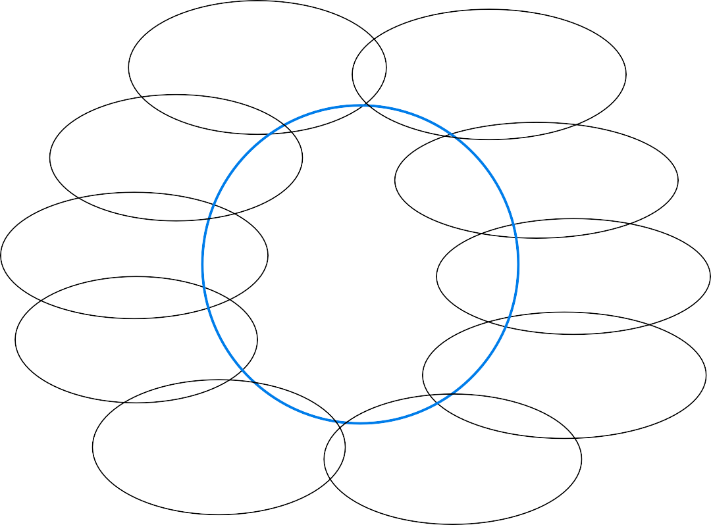
Other Related Fields
Madan Mohan Malaviya Univ. of Technology, Gorakhpur
data
mining
control theory
statistics
decision theory
information theory
machine learning
cognitive science
databases
psychological models
evolutionary models
neuroscience

Slide 16
Why Machine Learning ?
Madan Mohan Malaviya Univ. of Technology, Gorakhpur
No human experts
industrial/manufacturing control
mass spectrometer analysis, drug design, astronomic discovery
Black-box human expertise
face/handwriting/speech recognition
driving a car, flying a plane
Rapidly changing phenomena
credit scoring, financial modeling
diagnosis, fraud detection
Need for customization/personalization
personalized news reader
movie/book recommendation

Slide 17
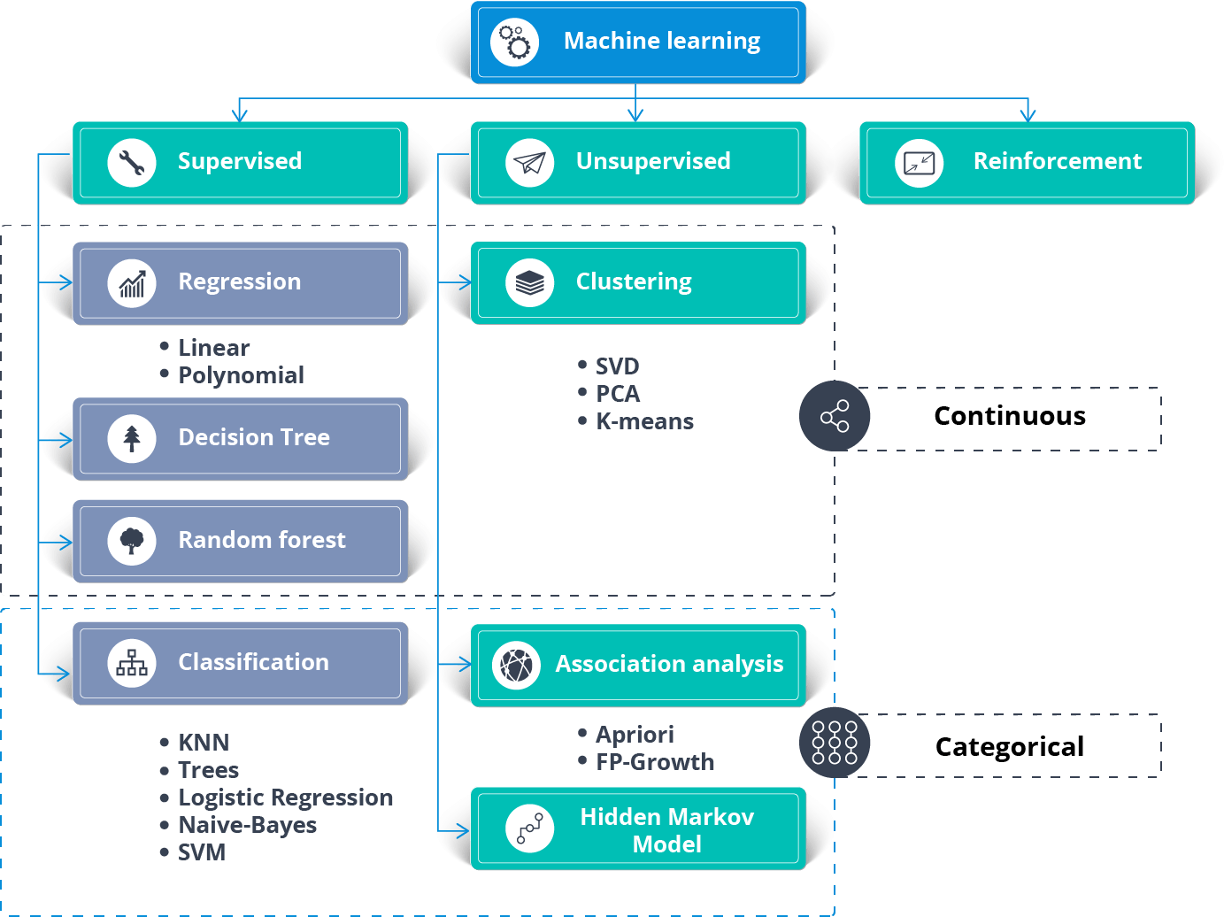
Machine Learning Algorithms
Madan Mohan Malaviya Univ. of Technology, Gorakhpur

Slide 18
Machine Learning Algorithms
Madan Mohan Malaviya Univ. of Technology, Gorakhpur
Reinforcement Algorithms
Q-Learning
Temporal Difference (TD)
Monte-Carlo Tree Search (MCTS)
Asynchronous Actor-Critic Agents (A3C)

Slide 19
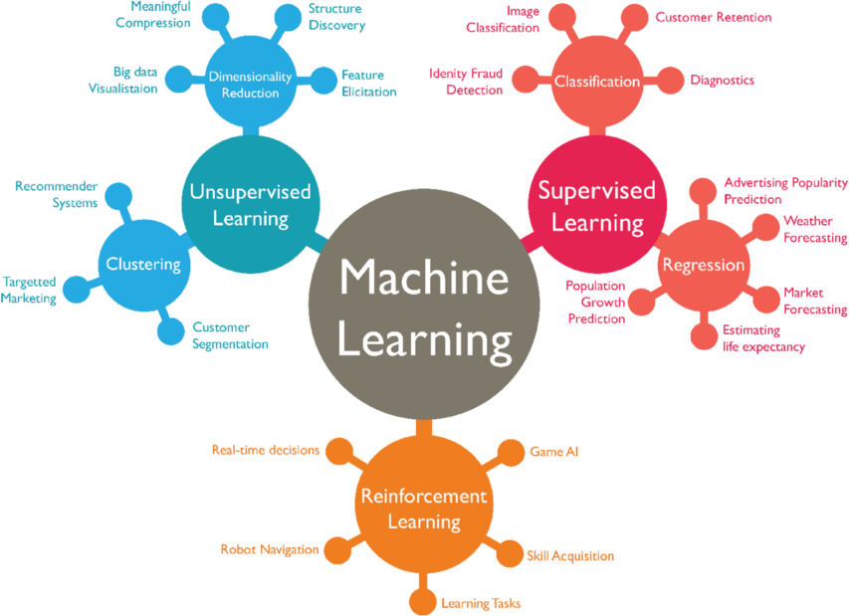
Madan Mohan Malaviya Univ. of Technology, Gorakhpur
Machine Learning Algorithms and their Applications

Slide 20
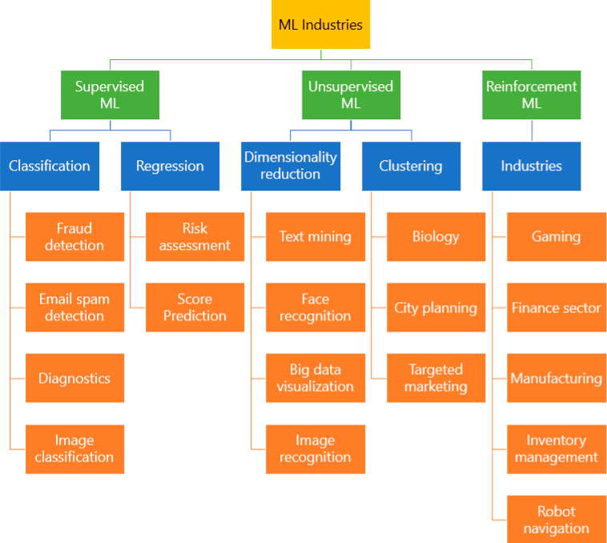
Madan Mohan Malaviya Univ. of Technology, Gorakhpur
Machine Learning Algorithms and their Applications

Slide 21
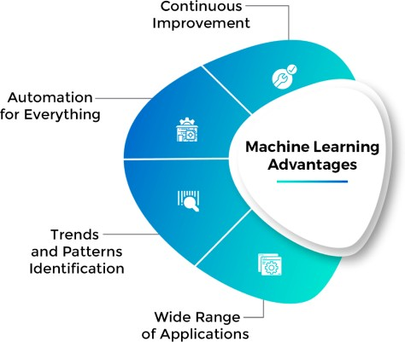
Advantage of Machine Learning
Madan Mohan Malaviya Univ. of Technology, Gorakhpur

Slide 22
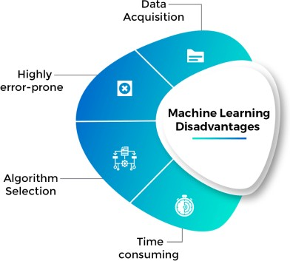
Disadvantage of Machine Learning
Madan Mohan Malaviya Univ. of Technology, Gorakhpur

Slide 23
Components of Learning
Madan Mohan Malaviya Univ. of Technology, Gorakhpur
Collecting and Preparing data
Choosing and Training a model
Evaluating that model
Prediction

Slide 24
How Machine Learning Works ?
Madan Mohan Malaviya Univ. of Technology, Gorakhpur
Phase-I (Learning or Training of Model)
Training data
Pre-processing
Learning or Training
Testing or Validation
Training data: Labelled or Un-labelled
Pre-processing: Normalization, dimension reduction, image processing such as noise removal, color image into grayscale image conversion etc
Learning or Training: Learning or Training of Model or Machine using Supervised or Un-supervised or Reinforcement or combination of these leaning methods
Testing or Validation: Cross verify training of Model or Machine whether Model or machine is correctly trained (learned) or not

Slide 25
How Machine Learning Works ?
Madan Mohan Malaviya Univ. of Technology, Gorakhpur
Phase-II (Prediction)
New data
Trained Model
Predicted data
New data: Actual data or real problem
Trained Model: Model or machine that took training in the phase-I
Predicted data: It is output or response of problem to be solved

Slide 26
Types of Learning used by Machine Learning
Madan Mohan Malaviya Univ. of Technology, Gorakhpur
Machine learning approaches are traditionally divided into three broad categories:
Supervised learning
Unsupervised learning
Reinforcement learning
Other machine learning approaches have been developed which don't fit neatly into these three categories, and sometimes more than one is used by the same machine learning system
For example topic modeling, dimensionality reduction or meta learning

Slide 27
Data and Data sets
Madan Mohan Malaviya Univ. of Technology, Gorakhpur
DATA: It can be any unprocessed fact, value, text, sound or picture that is not being interpreted and analyzed
INFORMATION: Data that has been interpreted and manipulated and has now some meaningful inference for the users
KNOWLEDGE: Combination of inferred information, experiences, learning and insights
Properties of Data:
Volume: Scale of Data. With growing world population and technology at exposure, huge data is being generated each and every millisecond
Variety: Different forms of data: healthcare, images, videos, audio clippings
Velocity: Rate of data streaming and generation
Value: Meaningfulness of data in terms of information which researchers can infer
from it
Veracity: Certainty and correctness in data we are working on

Slide 28
Data and Data sets
Madan Mohan Malaviya Univ. of Technology, Gorakhpur
Training data set:
The part of data which we use to train our model. It may be labelled or Un-labelled
Validation data set:
The part of data which is used to do a frequent evaluation of the trained machine or model, fit on training dataset
This data set is used to tune the hyperparameters
We use Cross Fold or Hold Out methods for validation

Slide 29
Data and Data sets
Madan Mohan Malaviya Univ. of Technology, Gorakhpur
Test data set:
Once our model is completely trained, testing data provides the unbiased evaluation
When we feed testing data as an input, our model will predict some values (without seeing actual output)
Actual data set
It is the data on which we perform operation (for which we trained,
validated and tested our machine or model)

Slide 30
Supervised Learning
Madan Mohan Malaviya Univ. of Technology, Gorakhpur
Supervised learning is a learning in which we train model or machine using labelled training data set in guidance of (trainer or teacher or supervisor)
Then the trained model or machine is presented with test data set to verify the result of the training and measure the accuracy
After that, trained model or machine is provided with a new set of data for prediction. The trained machine or model determines which label the new data belongs to (on the basis of prior given training)

Slide 31
How Supervised Learning Works ?
Madan Mohan Malaviya Univ. of Technology, Gorakhpur
Phase-I (Learning or Training of Model)
Training data
(labelled)
Pre-processing
Learning or Training
(using supervised method)
supervisor is here
Testing or Validation
Training data: Labelled
Pre-processing: Normalization, dimension reduction, image processing such as noise removal, color image into grayscale image conversion
Learning or Training: Learning or Training of Model or Machine using Supervised leaning method
Testing or Validation: Cross verify training of Model or Machine whether Model or
machine is correctly trained (learned) or not

Slide 32
How Supervised Learning Works ?
Madan Mohan Malaviya Univ. of Technology, Gorakhpur
Phase-II (Prediction)
New data
Trained Model
Predicted data
New data: actual data or real problem
Trained Model: Model or machine that took training in the phase-I
Predicted data: It is output or response of problem to be solved

Slide 33
Applications of Supervised Learning
Madan Mohan Malaviya Univ. of Technology, Gorakhpur
Supervised machine learning algorithms can be broadly divided into two types of algorithms:
Classification
Regression.

Slide 34
Classification
Madan Mohan Malaviya Univ. of Technology, Gorakhpur
Supervised learning problem that involves predicting a class label or category such as “Red” or “blue” or “disease” and “no disease”
Ex.
Decision Tree
Naive Bayes
ANN
KNN
SVM
Logistic Regression
Random Forest
Stochastic Gradient Descent

Slide 35
Regression
Madan Mohan Malaviya Univ. of Technology, Gorakhpur
Supervised learning problem that involves predicting a numerical label or real value such as “dollars” or “weight”
Ex.
Linear regression
Logistic regression
Polynomial regression
Stepwise regression
Ridge regression
Lasso regression
ElasticNet regression

Slide 36
Unsupervised Learning
Madan Mohan Malaviya Univ. of Technology, Gorakhpur
Unsupervised learning is a learning in which we train model or machine
using Un-labelled training data set with No guidance or supervision
Then the trained model or machine is presented with test data set to verify the result of the training and measure the accuracy
After that, trained model or machine is provided with a new set of data for prediction. The trained machine or model determines which label the new data belongs to (on the basis of prior given training)

Slide 37
How Unsupervised Learning Works ?
Madan Mohan Malaviya Univ. of Technology, Gorakhpur
Phase-I (Learning or Training of Model)
Training data
(un-labelled)
Pre-processing
Learning or Training
(using Un-supervised method)
No supervisor is here
Testing or Validation
Training data: Un-labelled
Pre-processing: Normalization, dimension reduction, image processing such as noise removal, color image into grayscale image conversion
Learning or Training: Learning or Training of Model or Machine using Un-supervised leaning method
Testing or Validation: Cross verify training of Model or Machine whether Model or
machine is correctly trained (learned) or not

Slide 38
How Unsupervised Learning Works ?
Madan Mohan Malaviya Univ. of Technology, Gorakhpur
Phase-II (Prediction)
New data
Trained Model
Predicted data
New data: actual data or real problem
Trained Model: Model or machine that took training in the phase-I
Predicted data: It is output or response of problem to be solved.

Slide 39
Unsupervised Learning
Madan Mohan Malaviya Univ. of Technology, Gorakhpur
It allows the model to work on its own devises to discover patterns and information that was previously undetected. It mainly deals with un- labelled data
For instance, suppose it is given an image having both dogs and cats which have not seen ever. Thus the model has no idea about the features of dogs and cats
It can categorize them according to their similarities, patterns, and differences

Slide 40
Applications of Unsupervised Learning
Madan Mohan Malaviya Univ. of Technology, Gorakhpur
Unsupervised machine learning algorithms can be broadly divided into several types:
Clustering
Dimensionality Reduction
Association
Density estimation
Visualization
Projection

Slide 41
Applications of Unsupervised Learning
Madan Mohan Malaviya Univ. of Technology, Gorakhpur
Clustering: Unsupervised learning problem that involves finding groups in data
Dimensionality Reduction: Unsupervised learning problem that reducing
the number of variables in a data set
Association: Unsupervised learning problem that identifying sets of items in a data set that frequently occur together
Density Estimation: Unsupervised learning problem that involves
summarizing the distribution of data
Visualization: Unsupervised learning problem that involves creating plots of data
Projection: Unsupervised learning problem that involves creating lower- dimensional representations of data

Slide 42
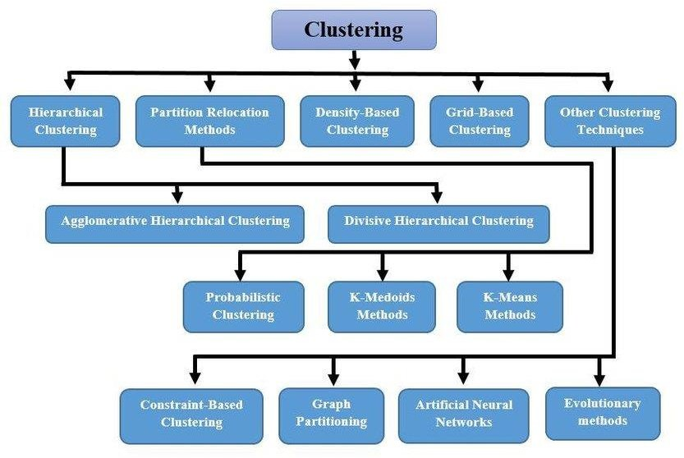
Clustering Techniques
Madan Mohan Malaviya Univ. of Technology, Gorakhpur

Slide 43
Dimensionality Reduction Techniques
Madan Mohan Malaviya Univ. of Technology, Gorakhpur
Missing Values Ratio
Low Variance Filter
High Correlation Filter
Random Forests/Ensemble Trees
Principal Component Analysis (PCA)
Backward Feature Elimination
Forward Feature Construction

Slide 44
Association Rules
Madan Mohan Malaviya Univ. of Technology, Gorakhpur
Support
Confidence
Lift
Conviction

Slide 45
Association Algorithms
Madan Mohan Malaviya Univ. of Technology, Gorakhpur
Many algorithms for generating association rules:
Apriori algorithm
Eclat algorithm
FP-growth algorithm

Slide 46
Reinforcement Learning
Madan Mohan Malaviya Univ. of Technology, Gorakhpur
Reinforcement learning is a learning that allows the agent to decide the best next action based on its current state by learning behaviors that will maximize the reward
Three major components make up reinforcement learning: the agent, the environment, and the actions. The agent is the learner or decision-maker, the environment includes everything that the agent interacts with, and the actions are what the agent does
Reinforcement learning occurs when the agent chooses actions that maximize the expected reward over a given time period. This is easiest to achieve when the agent is working within a sound policy framework

Slide 47
Reinforcement Learning
Madan Mohan Malaviya Univ. of Technology, Gorakhpur
Reinforcement learning describes a class of problems where an agent operates in an environment and learn using feedback
The learner (agent) is not told which actions to take, but instead must discover which actions yield the most reward by trying them
It focuses on finding a balance between exploration (new) and exploitation
(of current knowledge)
Reinforcement algorithms usually learn optimal actions through trial and error.

Slide 48
Reinforcement Learning
Madan Mohan Malaviya Univ. of Technology, Gorakhpur
Since, training dataset is un-labelled, it is bound to learn from its experience
Here, model is trained with agency, AKA “agents”
As compared to unsupervised learning, reinforcement learning is different in terms of goals.
While the goal in unsupervised learning is to find similarities and differences
between data points
In reinforcement learning the goal is to find a suitable action model that would maximize the total cumulative reward of the agent

Slide 49
Reinforcement Learning
Madan Mohan Malaviya Univ. of Technology, Gorakhpur
Example
There are robot (agent), diamond (goal), and fire. The goal of the robot is to get the reward that is the diamond and avoid the hurdles that are fire. The robot learns by trying all the possible paths and then choosing the path which gives him the reward with the least hurdles. Each right step will give the robot a reward and each wrong step will subtract the reward of the robot. The total reward will be calculated when it reaches the final reward that is the diamond

Slide 50
Type of Reinforcement Learning
Madan Mohan Malaviya Univ. of Technology, Gorakhpur
Positive
Negative

Slide 51
Reinforcement Learning Algorithms
Madan Mohan Malaviya Univ. of Technology, Gorakhpur
Q-Learning
Temporal Difference (TD)
Monte-Carlo Tree Search (MCTS)
Asynchronous Actor-Critic Agents (A3C)

Slide 52
Learning Models
Madan Mohan Malaviya Univ. of Technology, Gorakhpur
Geometric Models
Probabilistic Models
Logical Models

Slide 53
Learning Models
Madan Mohan Malaviya Univ. of Technology, Gorakhpur
Geometric Models
In Geometric models, features could be described as points in two dimensions (x- and y-axis) or a three-dimensional space (x, y, and z). Even when features are not intrinsically geometric, they could be modelled in a geometric manner (for example, temperature as a function of time can be modelled in two axes). In geometric models, there are two ways we could impose similarity.
We could use geometric concepts like lines or planes to segment (classify) the instance space. These are called Linear models
Alternatively, we can use the geometric notion of distance to represent similarity. In this case, if two points are close together, they have similar values for features and thus can be classed as similar. We call such models as Distance-based models

Slide 54
Learning Models
Madan Mohan Malaviya Univ. of Technology, Gorakhpur
Probabilistic Models
Probabilistic models see features and target variables as random variables. The process of modelling represents and manipulates the level of uncertainty with respect to these variables. There are two types of probabilistic models: Predictive and Generative.
Predictive probability models use the idea of a conditional probability distribution P (Y |X) from which Y can be predicted from X
Generative models estimate the joint distribution P (Y, X). Once we know the joint distribution for the generative models, we can derive any conditional or marginal distribution involving the same variables
Probabilistic models use the idea of probability to classify new entities Naïve Bayes is an example of a probabilistic classifier.

Slide 55
Learning Models
Madan Mohan Malaviya Univ. of Technology, Gorakhpur
Logical Models
Logical models use a logical expression to divide the instance space into segments and hence construct grouping models. A logical expression is an expression that returns a Boolean value, i.e., a True or False outcome. Once the data is grouped using a logical expression, the data is divided into homogeneous groupings for the problem we are trying to solve.
There are two types of logical models: Tree models and Rule models.
Rule models consist of a collection of implications or IF-THEN rules. For tree-based models, the ‘if-part’ deﬁnes a segment and the ‘then-part’ deﬁnes the behaviour of the model for this segment. Rule models follow the same reasoning
Tree models can be seen as a particular type of rule model where the if- parts of the rules are organised in a tree structure. Both Tree models and Rule models use the same approach to supervised learning

Slide 56
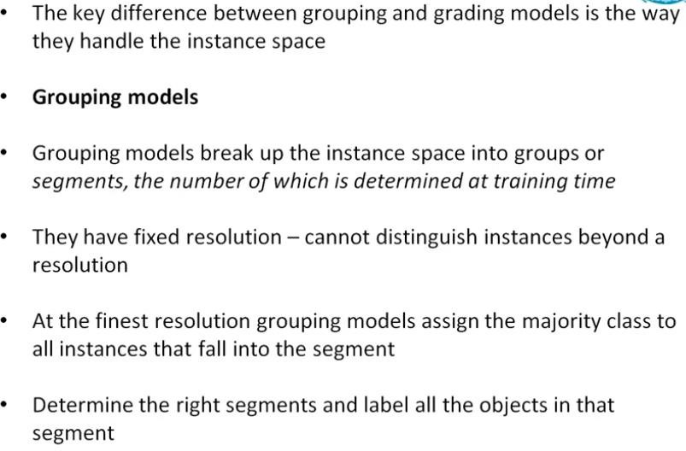
Madan Mohan Malaviya Univ. of Technology, Gorakhpur
Learning Models
Groping and Grading Models

Slide 57
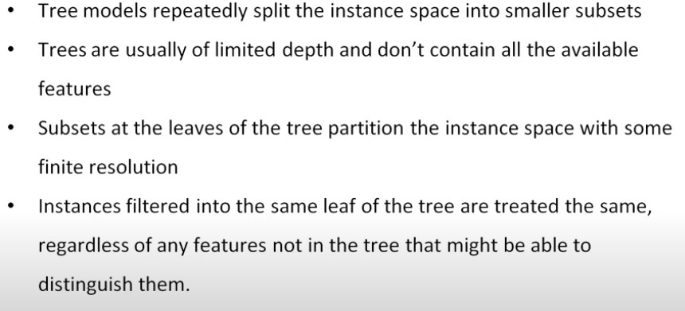
Madan Mohan Malaviya Univ. of Technology, Gorakhpur
Learning Models
Groping Models

Slide 58
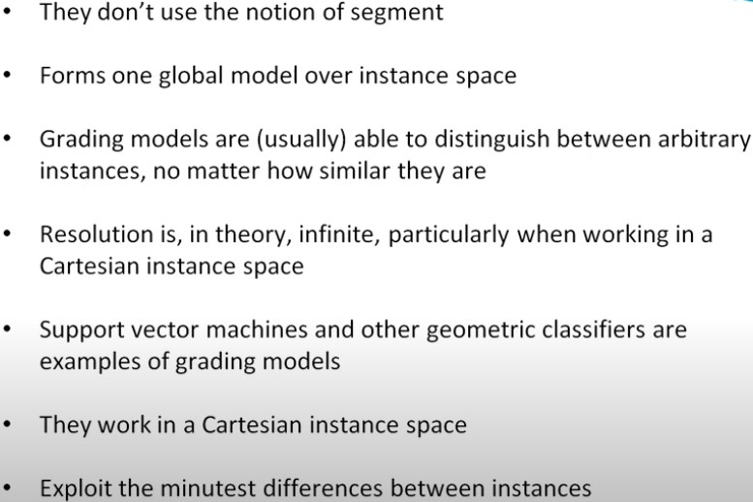
Madan Mohan Malaviya Univ. of Technology, Gorakhpur
Learning Models
Grading Models

Slide 59
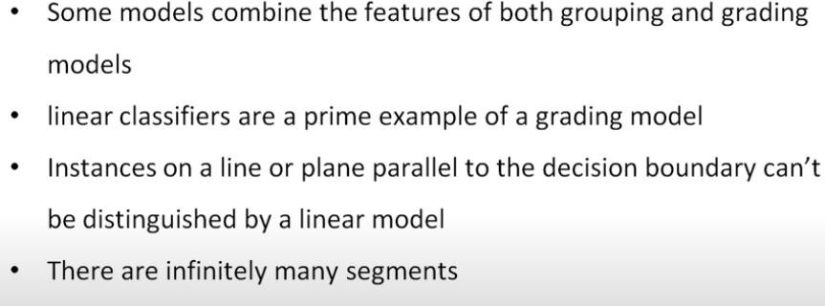
Madan Mohan Malaviya Univ. of Technology, Gorakhpur
Learning Models
Groping versus Grading Models

Slide 60
Learning Versus Design
Madan Mohan Malaviya Univ. of Technology, Gorakhpur
Machine learning is a powerful tool that drives everything from curated
content recommendations to optimized user interfaces
Machine learning answers questions about user behavior
Machine learning customizes interfaces to users needs
Digital product designers need to get familiar with machine learning
Many warn that designers who don’t start learning about ML will be left behind. But I haven’t seen one that has explored what design and machine learning have to offer each other
Design and machine learning function like a flywheel: when connected, each provides value to the other. Together, they open up new product experiences and business value
Design helps machine learning gather better data

Slide 61
Learning Versus Design
Madan Mohan Malaviya Univ. of Technology, Gorakhpur
Machine learning is a hungry beast. To deliver the best results, learning algorithms need vast amounts of detailed data, clean of any confounding factors or built-in biases
Designers can help create user experiences that eliminate noise in data, leading to more accurate and efficient ML-powered applications
Design helps set expectations and establish trust with users

Slide 62
Error and Noise
Madan Mohan Malaviya Univ. of Technology, Gorakhpur
Error
Error measures are a tool in ML that quantify the question “how wrong was our estimation”. It is a function that compares the output of a learned hypothesis with the output of the real target function. What this means in practice is that we compare the prediction of our model with the real value in data. An error measure is expressed as E(h, f) (a hypothesis h ∈ H, and f is the target function). E is almost always pointwise. It is defined by the difference at two points, therefore, we use the pointwise definition of the error measure e() to compute this error in the different points: e(h(x), f(x)).
Examples:
Squared error: e(h(x), f(x)) = (h(x)- f(x))²
Binary error: e(h(x), f(x)) = ⟦h(x) ≠ f(x)⟧ (the number of wrong
classifications)

Slide 63
Error and Noise
Madan Mohan Malaviya Univ. of Technology, Gorakhpur
Noise
It refers to the irrelevant information or randomness in a dataset. We can express noisy target as follows:
Noisy target= deterministic target + noise = 𝔼[y|x] + ε where ε = (y - f(x)) is the difference between the outcome and the predicted value.
𝔼[y|x] is the expected value of y knowing x, y is our prediction using the target function h(x) and f(x) is the real value of the data point.
We introduced P(y|x) into our learning scheme to account for the fact that there will always be noise in the relationship between x and y while P(x) represents the random variable x and is necessary for us to use Hoeffding‘s inequality.

Slide 64
Training versus Testing
Madan Mohan Malaviya Univ. of Technology, Gorakhpur
In a dataset, a training set is implemented to build up a model, while a test (or validation) set is to validate the model built. Data points in the training set are excluded from the test (validation) set
In Machine Learning, we basically try to create a model to predict the test
data
Usually, a dataset is divided into a training set, a validation set (some people use ‘test set’ instead) in each iteration, or divided into a training set, a validation set and a test set in each iteration

Slide 65
Training versus Testing
Madan Mohan Malaviya Univ. of Technology, Gorakhpur
Sets:
Training Set: Here, you have the complete training dataset. You can extract features and train to fit a model and so on
Validation Set: This is crucial to choose the right parameters for your estimator. We can divide the training set into a train set and validation set. Based on the validation test results, the model can be trained(for instance, changing parameters, classifiers)
Testing Set: Here, once the model is obtained, you can predict using the model obtained on the training set

Slide 66
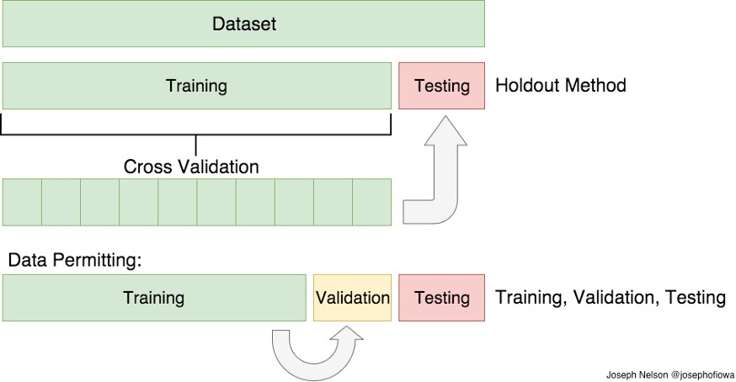
Training versus Testing
Madan Mohan Malaviya Univ. of Technology, Gorakhpur

Slide 67
Theory of Generalization
Madan Mohan Malaviya Univ. of Technology, Gorakhpur
In machine learning, generalization usually refers to the ability of an algorithm to be effective across a range of inputs and applications
Our key working assumption is that data is generated by an underlying, unknown distribution D. Rather than accessing the distribution directly, statistical learning assumes that we are given a training sample S, where every element of S is i.i.d and generated according to D. A learning algorithm chooses a function (hypothesis h) from a function space (hypothesis class) H where H = {f(x, α)} where α is the parameter vector
We can then define the generalization error of a hypothesis h as the difference between the expectation of the error on a sample x picked from the distribution D and the empirical loss

Slide 68
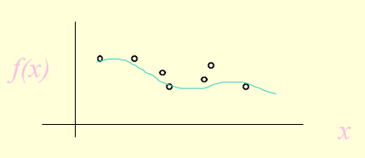
Generalization
Madan Mohan Malaviya Univ. of Technology, Gorakhpur
The objective of learning is to achieve good generalization to new cases, otherwise just use a look-up table
Generalization can be defined as a mathematical interpolation or regression over a set of training points:

Slide 69
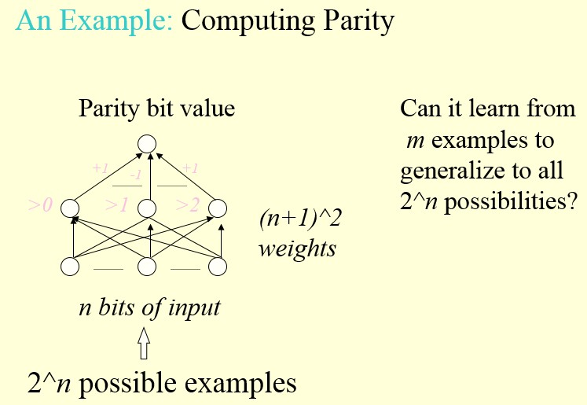
Generalization
Madan Mohan Malaviya Univ. of Technology, Gorakhpur

Slide 70
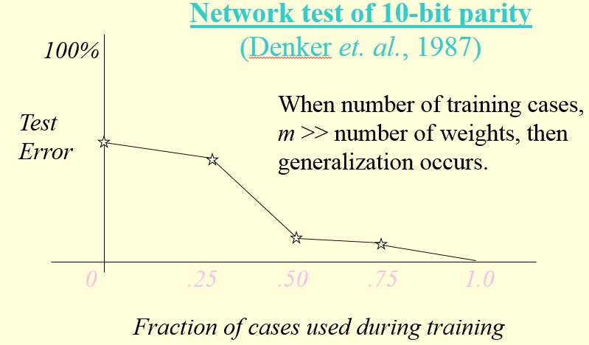
Generalization
Madan Mohan Malaviya Univ. of Technology, Gorakhpur

Slide 71
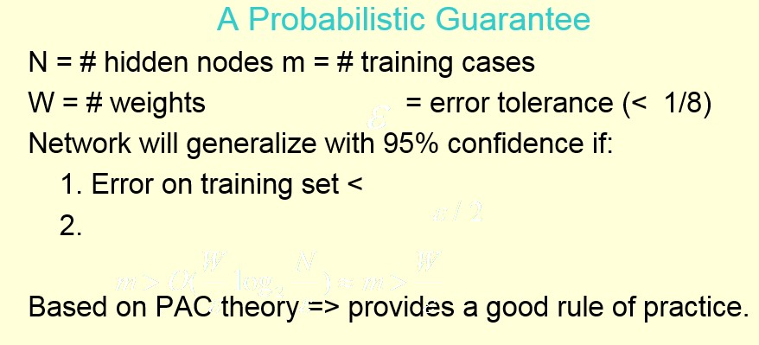
Generalization
Madan Mohan Malaviya Univ. of Technology, Gorakhpur

Slide 72
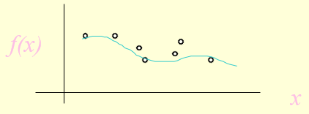
Generalization
Madan Mohan Malaviya Univ. of Technology, Gorakhpur
The objective of learning is to achieve good generalization to new cases, otherwise just use a look-up table
Generalization can be defined as a mathematical interpolation or
regression over a set of training points:

Slide 73
Generalization
Madan Mohan Malaviya Univ. of Technology, Gorakhpur
Over-Training
Is the equivalent of over-fitting a set of data points to a curve
which is too complex
Occam’s Razor (1300s): “plurality should not be assumed without necessity”
The simplest model which explains the majority of the data is usually the best

Slide 74
Generalization
Madan Mohan Malaviya Univ. of Technology, Gorakhpur
Preventing Over-training
Use a separate test or tuning set of examples
Monitor error on the test set as network trains
Stop network training just prior to over-fit error occurring- early stopping or tuning
Number of effective weights is reduced
Most new systems have automated early stopping methods

Slide 75
Generalization
Madan Mohan Malaviya Univ. of Technology, Gorakhpur
How can we control number of effective weights?
Manually or automatically select optimum number of hidden nodes and connections
Prevent over-fitting = over-training
Add a weight-cost term to the bp error equation

Slide 76
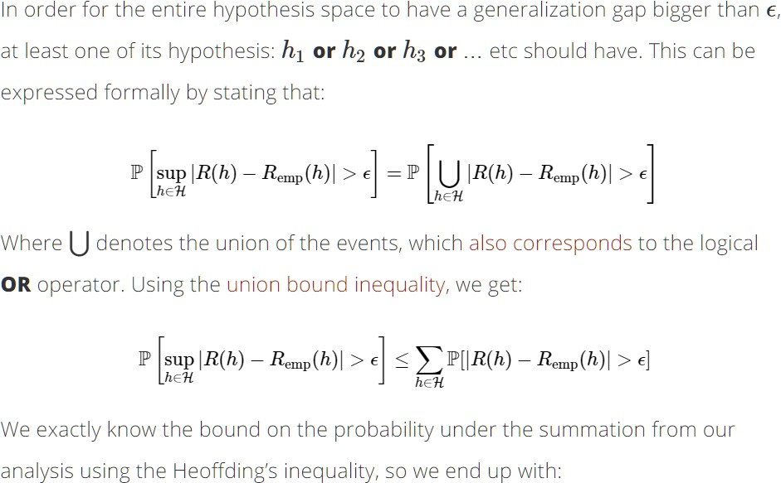
Generalization Bound
Madan Mohan Malaviya Univ. of Technology, Gorakhpur

Slide 77
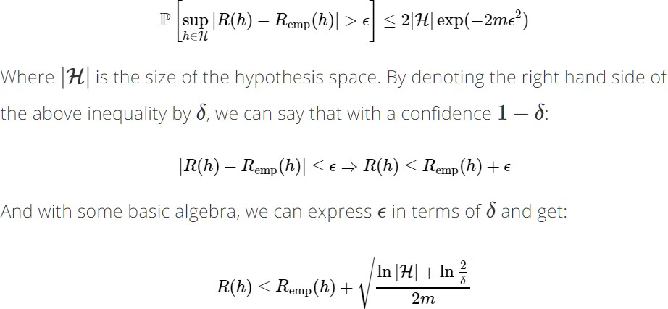
Generalization Bound
Madan Mohan Malaviya Univ. of Technology, Gorakhpur

Slide 78
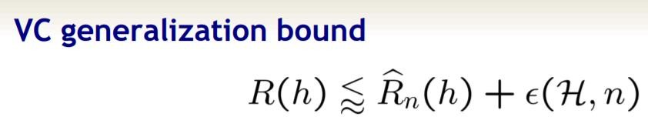
Generalization Bound
Madan Mohan Malaviya Univ. of Technology, Gorakhpur
There are two types of bound
VC generalization bound
Distributed function based bound

Slide 79
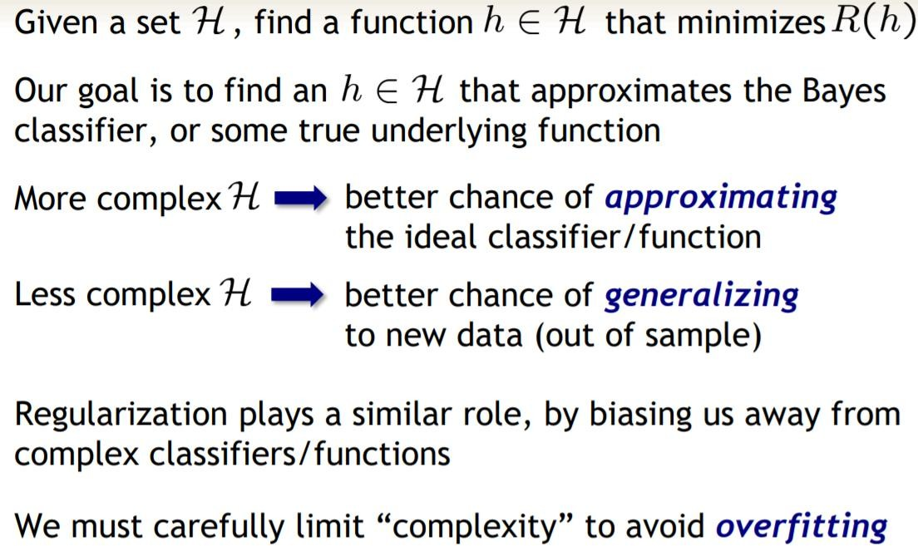
Madan Mohan Malaviya Univ. of Technology, Gorakhpur
Approximation- Generalization Tradeoff

Slide 80
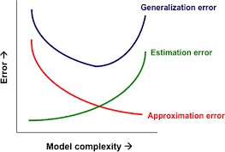
Madan Mohan Malaviya Univ. of Technology, Gorakhpur
Approximation- Generalization Tradeoff

Slide 81
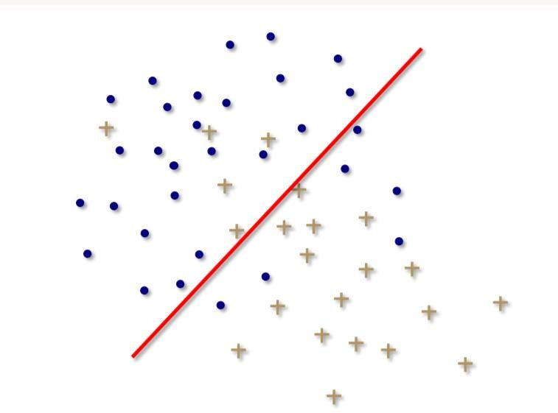
Overfitting
Madan Mohan Malaviya Univ. of Technology, Gorakhpur

Slide 82
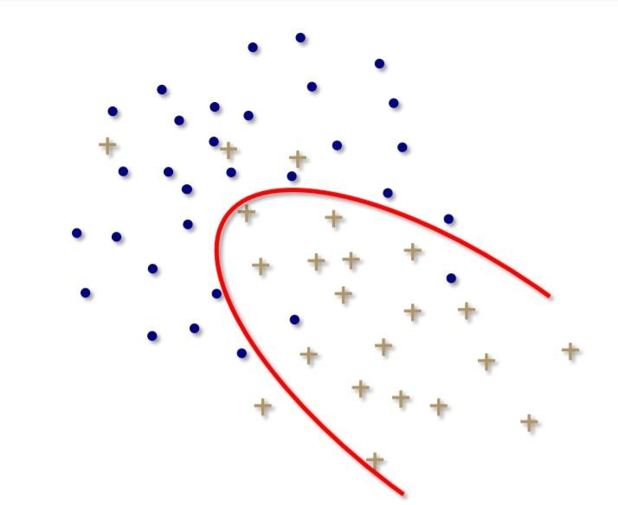
Overfitting
Madan Mohan Malaviya Univ. of Technology, Gorakhpur

Slide 83
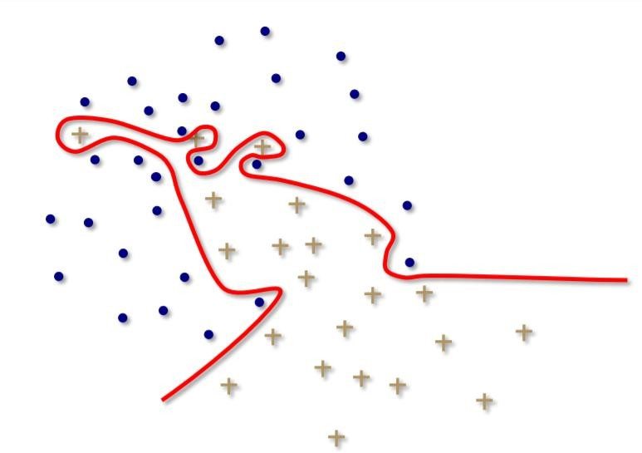
Overfitting
Madan Mohan Malaviya Univ. of Technology, Gorakhpur

Slide 84
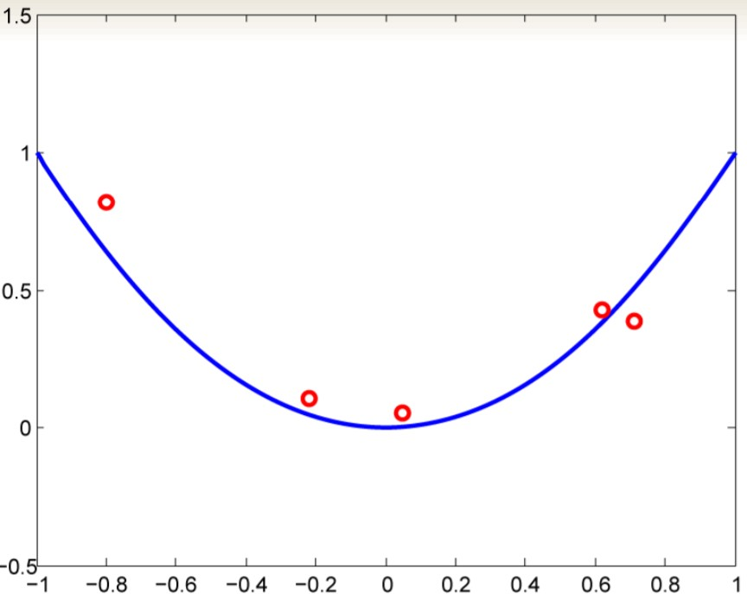
Overfitting
Madan Mohan Malaviya Univ. of Technology, Gorakhpur

Slide 85
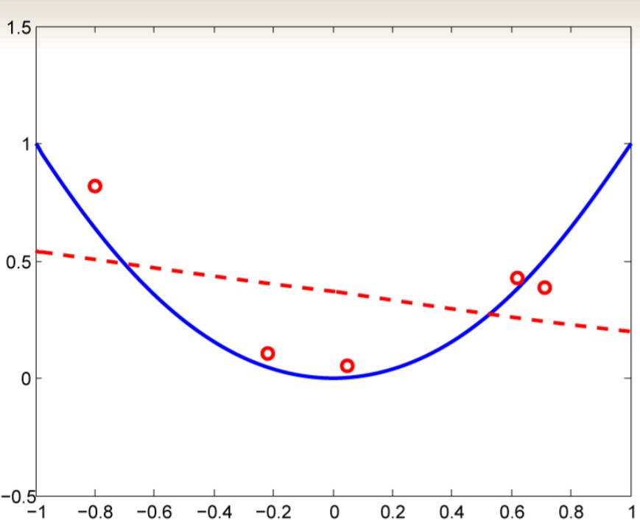
Overfitting
Madan Mohan Malaviya Univ. of Technology, Gorakhpur

Slide 86
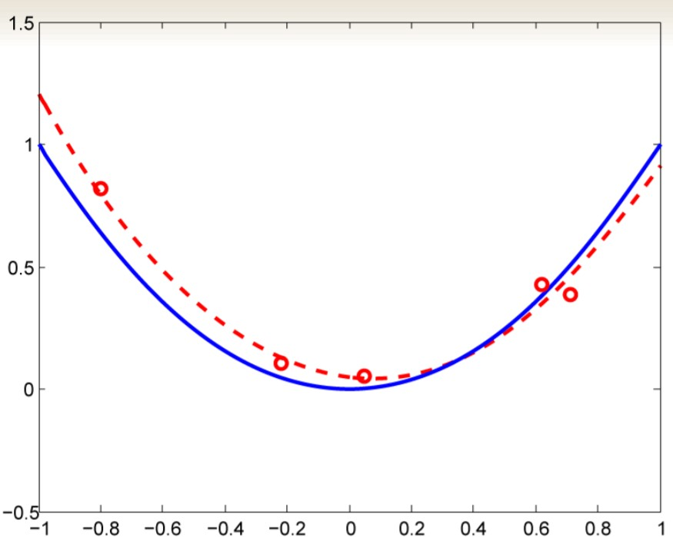
Overfitting
Madan Mohan Malaviya Univ. of Technology, Gorakhpur

Slide 87
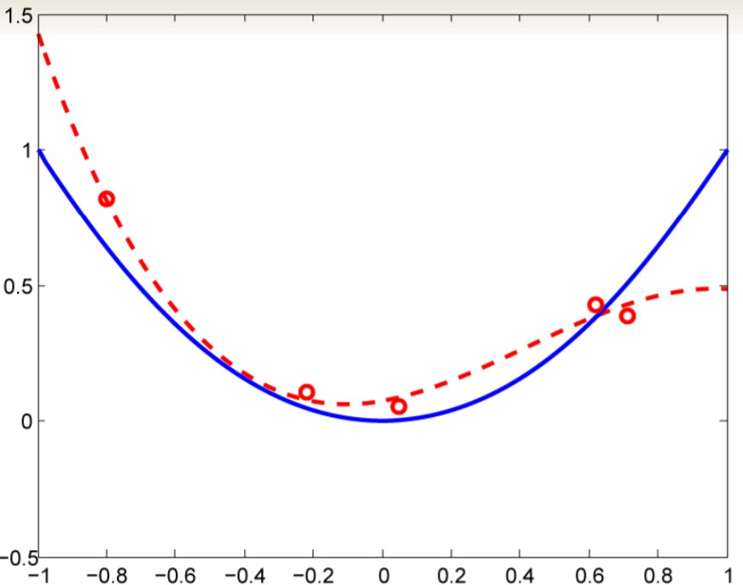
Overfitting
Madan Mohan Malaviya Univ. of Technology, Gorakhpur

Slide 88
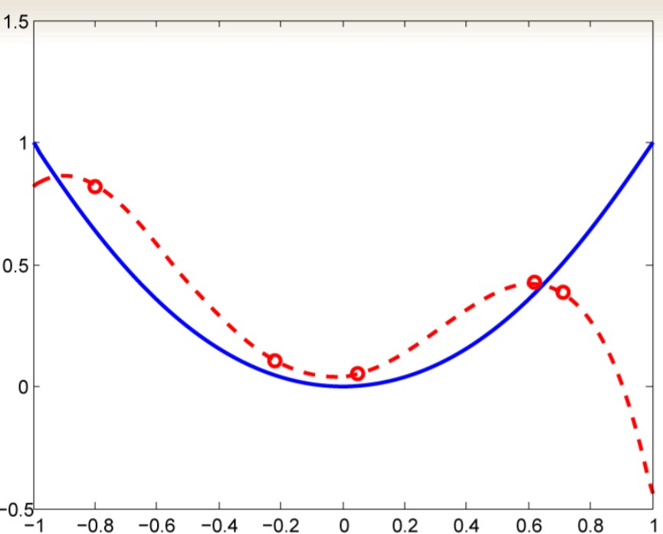
Overfitting
Madan Mohan Malaviya Univ. of Technology, Gorakhpur

Slide 89
Bias and Variance
Madan Mohan Malaviya Univ. of Technology, Gorakhpur
Bias
Bias is the difference between the Predicted Value and the Expected Value.
Mathematically, let the input variables be X and a target variable Y. We map the relationship between the two using a function f. Therefore,
Y = f(X) + e
Here ‘e’ is the error that is normally distributed. The aim of our model f'(x) is to predict values as close to f(x) as possible. Here, the Bias of the model is:
Bias[f'(X)] = E[f'(X) – f(X)]
As I explained above, when the model makes the generalizations i.e. when there is a high bias error, it results in a very simplistic model that does not consider the variations very well. Since it does not learn the training data very well, it is called Underfitting.

Slide 90
Bias and Variance
Madan Mohan Malaviya Univ. of Technology, Gorakhpur
Variance
Contrary to bias, the Variance is when the model takes into account the fluctuations in the data i.e. the noise as well. So, what happens when our model has a high variance?
The model will still consider the variance as something to learn from. That is, the model learns too much from the training data, so much so, that when confronted with new (testing) data, it is unable to predict accurately based on it.
Mathematically, the variance error in the model is:
Variance[f(x))=E[X^2]−E[X]^2
Since in the case of high variance, the model learns too much from the training data, it is called overfitting.

Slide 91
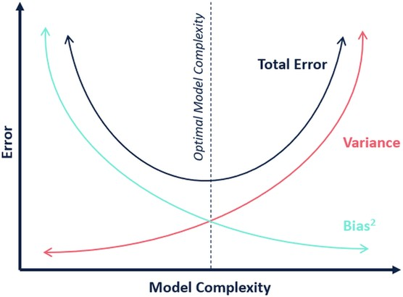
Bias and Variance
Madan Mohan Malaviya Univ. of Technology, Gorakhpur

Slide 92
Learning curves
Madan Mohan Malaviya Univ. of Technology, Gorakhpur
Learning curves are plots that show changes in learning performance over time in terms of experience
Learning curves of model performance on the train and validation
datasets can be used to diagnose an underfit, overfit, or well-fit model
Learning curves of model performance can be used to diagnose whether the train or validation datasets are not relatively representative of the problem domain
Generally, a learning curve is a plot that shows time or experience on the
x-axis and learning or improvement on the y-axis
Learning curves are deemed effective tools for monitoring the performance of workers exposed to a new task. LCs provide a mathematical representation of the learning process that takes place as task repetition occurs.

Slide 93
Learning curves
Madan Mohan Malaviya Univ. of Technology, Gorakhpur
Train Learning Curve: Learning curve calculated from the training
dataset that gives an idea of how well the model is learning
Validation Learning Curve: Learning curve calculated from a hold-out
validation dataset that gives an idea of how well the model is
generalizing
Optimization Learning Curves: Learning curves calculated on the metric by which the parameters of the model are being optimized, e.g. loss
Performance Learning Curves: Learning curves calculated on the
metric by which the model will be evaluated and selected, e.g. accuracy
There are three common dynamics that you are likely to observe in learning curves; they are:
Underfit
Overfit
Good Fit

Slide 94
Learning curves
Madan Mohan Malaviya Univ. of Technology, Gorakhpur
Underfitting refers to a model that cannot learn the training dataset.
A plot of learning curves shows underfitting if:
The training loss remains flat regardless of training
The training loss continues to decrease until the end of training
Overfitting refers to a model that has learned the training dataset too well, including the statistical noise or random fluctuations in the training dataset.
A plot of learning curves shows overfitting if:
The plot of training loss continues to decrease with experience
The plot of validation loss decreases to a point and begins increasing again

Slide 95
Learning curves
Madan Mohan Malaviya Univ. of Technology, Gorakhpur
A good fit is the goal of the learning algorithm and exists between an overfit and underfit model
A good fit is identified by a training and validation loss that decreases to a point of stability with a minimal gap between the two final loss values
A plot of learning curves shows a good fit if:
The plot of training loss decreases to a point of stability
The plot of validation loss decreases to a point of stability and has a small gap with the training loss

Slide 96
THANK YOU

